Slide 1
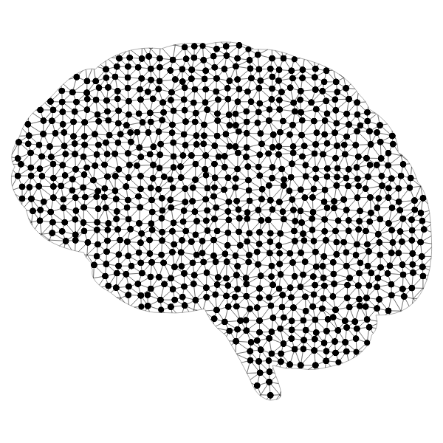

Creating Your Own AI Tool In MATLAB

Slide 2
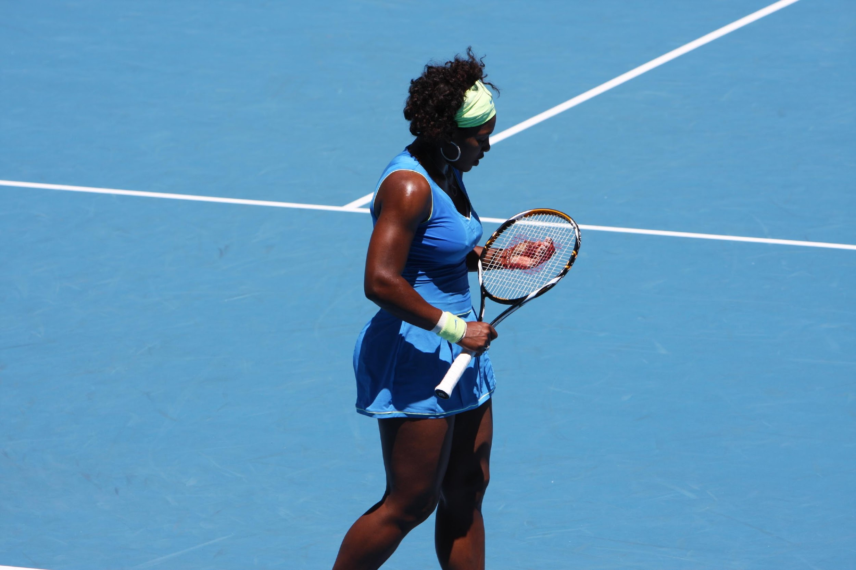
Brainstorm Session
Final Project: “Students will compile all that they’ve learned in the previous programming and AI lessons to start on the final project. They will choose their musician or athlete and begin compiling data to sort or extract from. Students will then decide on a machine learning model that will best suit their data, and then implement the model in MATLAB.”
Thinking about the final project outlined above, brainstorm some initial ideas and write them down.
Consider the following:
Think about what sort of data you need and where you could get it
Think about what you have learned in the AI section and how you could apply that to approach this project
Additionally, consider what parameters determine success.
Discuss your ideas with a partner!

Slide 3
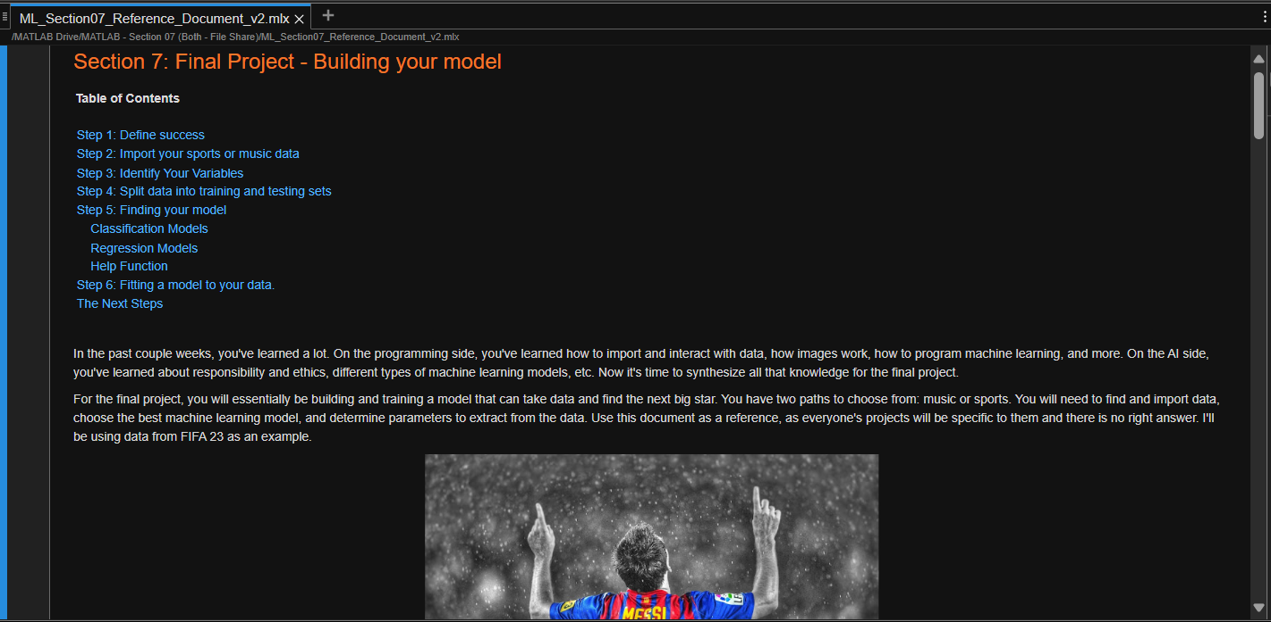
Building Your Model
Please copy over the files for Section 07 from the MATLAB Drive
The MATLAB files for this section can be found at this link.
Notes:
The URL on this slide is for the student version of the files, please see the teacher guide for the teacher version of the files You can also find the teacher and student links on the master document with all the youtube video and matlab drive links for every section on it

Slide 4

Building Your Model
Introduction
For the final project, you will be building and training a model that can take data and find the next big star. You have two paths to choose from: music or sports.
You will need to:
Find and import data,
Choose the best machine learning model
Determine parameters to extract from data
Use this document as a reference, as everyone's projects will be specific to them and there is no right answer. In this reference guide, we’ll be showing you how to create a linear regression model using data from FIFA 23 male players.csv file.
"Lionel Messi" by theglobalpanorama is licensed under CC BY-SA 2.0.

Slide 5

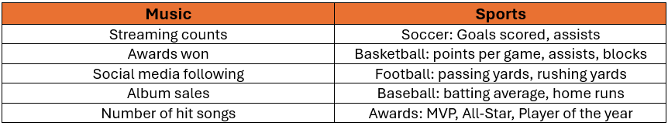

Building Your Model
Step 1: Define Success
Define what success means. What makes the next big athlete or music star popular and successful? When defining success select a variable that provides the most complete picture of an athlete's or musician's ability. Below are some metrics that may be used to define success in the music and sports industries.
Can you think of other metrics?

Slide 6
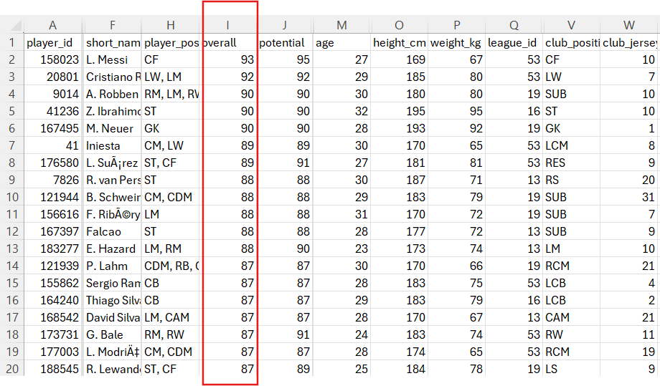
Building Your Model
Step 1: Define Success
For this example, the success metric is going to be the Overall column from the FIFA 23 data. The Overall score considers the players' scores on various skills such as pace, defense, power, etc.
The image on the right shows the data we’ll be using.

Slide 7

Building Your Model
Step 2: Import Your Data
In lesson 2, you learned how to locate and import data from various means. You've been provided a file about FIFA 2023 male players. Let's import it into MATLAB.
You can use other methods that you've learned to obtain data, such as using API's or webscraping.
for Spotify's API, see Lesson 3 development notebook
for a sports API, see lesson 3 extension activity
for webscraping, see Webscraping file

Slide 8

Building Your Model
Step 3: Identify Your Variables
For most supervised machine learning models, it is necessary to split your data into predictor variables and response variables. The purpose of the model is to use the predictor variables to understand the response variable.
In this example, the response variable is the players' Overall scores and the predictors would be their skill scores. In the FIFA 23 data, there are many skill scores, but we are only going to use a few general skill scores such as shooting, passing, dribbling, and defending.
Response variable: Players' Overall scores
Predictor variables: Shooting, passing, dribbling, and defending.

Slide 9
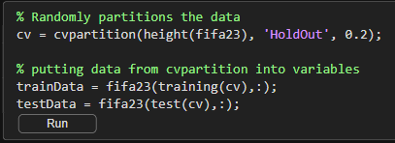
Building Your Model
Step 4: Split data into training and testing sets
Splitting the data prevents overfitting and underfitting. Overfitting means that your model can only recognize very specific patterns. Underfitting is the opposite, where the model can't recognize patterns because it's looking for patterns that are too broad.
To split the data, we're going to use the cvpartition() function. The code block below shows how to use this function.
The inputs in the function are as follows:
n- number of observations
'HoldOut'- this tells the function to divide the observations into a training set and a test (holdout) set
p- the proportion of the dataset to hold out as the test set (commonly is 0.2)
Note: sometimes missing values such as NaNs in your data will need to be removed prior to partitioning the data into training and testing sets. This can be done using functions such as rmmissing().

Slide 10
Building Your Model
Step 5: Finding Your Model
Your type of model depends on whether you define success as a continuous value (e.g., player goals each season) or a category (e.g., "successful" vs "not successful").
Regression models are used for continuous metrics, and classification models are for categorical. The table below contains links to the documentation of regression and classification models that may be useful.
Classification Models | Regression Models
Decision Trees | Linear Regression
Discriminant Analysis | Generalized Linear Models
Naïve Bayes | Nonlinear Regression
Nearest Neighbors | Support Vector Machine Regression

Slide 11
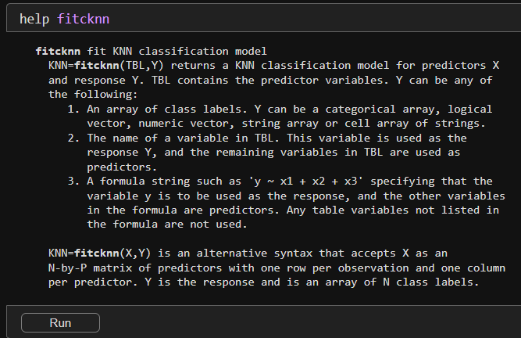
Building Your Model
Step 5: Finding Your Model
Help Function
If you need a quick review or additional help with a function, you can use the help function. If you want to keep it out of your code, run the command in the Command Window rather than the live script.
The help function will give you an overview what you can do with a specific function.

Slide 12
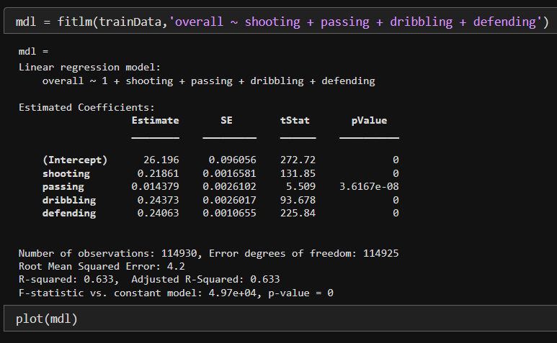
Building Your Model
Step 6: Fitting a Model to Your Data
For this example, we’re going to fit a linear regression model. A linear regression model is a mathematical method that finds the best-fitting straight line through a set of data points, representing the relationship between an independent variable (input) and a dependent variable (output). It is used to predict the value of the dependent variable based on the value of the independent variable.
The next step is to fit the model to your data so let's fit a linear regression model to see what relationship shooting, passing, dribbling, and defending have to a player's overall score.

Slide 13
Building Your Model
The Next Steps
After completing the 6 steps on the previous slides, you should have a better understanding on how to train an AI model. The remaining steps include using an AI model to make predictions and assessing the model’s accuracy. We will be continuing this example and completing the remaining steps in section 08.
Section 08 will focus on evaluating the model's performance. The goal is that while completing these last two sections you’ll be able to evaluate, refine, and finalize your model.
Feel free to explore models beyond linear regression. The MATLAB Drive also provides a step-by-step example illustrating how to create a KNN classification model, similar to the one discussed in Section 05. That example is specifically related to the music industry, so feel free to check it out if that piques your interest.

Slide 14
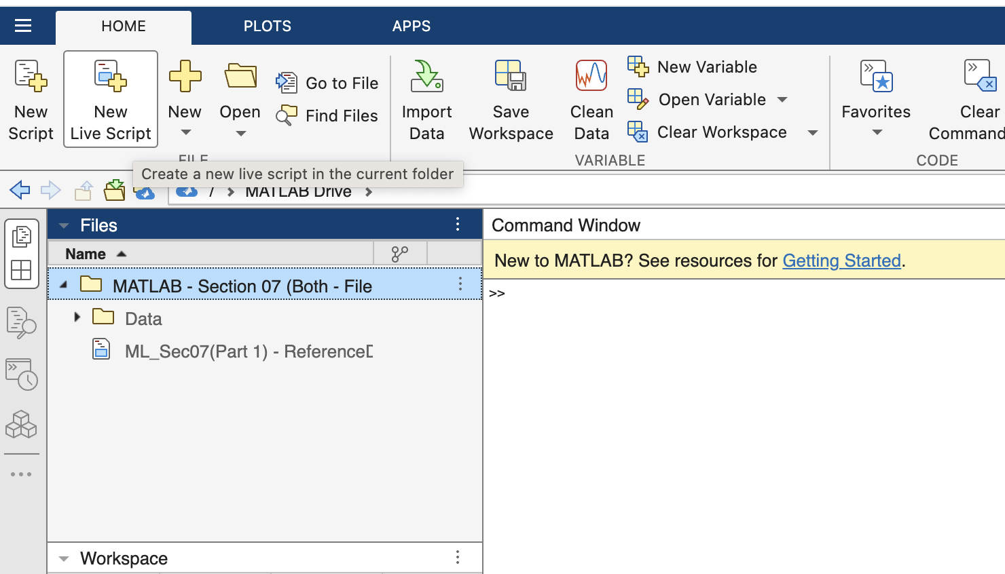
Starting Your Final Project
Using the “Section 7: Final Project – Building your model” file from the lecture as a reference, begin your final project!
Use your remaining time to begin working on your own model. Once you feel comfortable with the first 6 steps move on to section 08 to finalize your model.
Create a new Live Script file to work on your final project!
Notes:
The URL on this slide is for the student version of the files, please see the teacher guide for the teacher version of the files You can also find the teacher and student links on the master document with all the youtube video and matlab drive links for every section on it

Slide 15

Big Picture
Let's think about the lesson and activity we just did:
In this lesson we learned how to import, prepare, and modify data. We then found the appropriate model for our data and practiced fitting the model to our data.
Knowing this, discuss the following in groups:
If you completed training your model, how can you begin to evaluate? Brainstorm ideas and review previous notes.
If you have not completed training your model, brainstorm the next steps needed to accomplish this task.

